Slide 1


Virtual Coaching Deep Learning Project
A Journey through Data Collection and Annotations

Slide 2

Team Members
Rana Mohamed Zayed | 7756
Morouge Mahmoud Ghazal | 7524
Saifallah Mohamed Sayed | 7696
Saad Eldine Ahmed Saad | 7370

Slide 3
Table of contents
01
04
02
05
03
06
Objectives
Obstacles and Solutions
Resources
Data Collection and Annotations
Timeline
Conclusion

Slide 4

01
Objectives
of the project

Slide 5
Objectives
Our aim
To develop an advanced virtual coaching system utilizing deep learning technologies that can accurately evaluate and provide feedback on exercise performance. This system aims to aid both professional athletes and general fitness enthusiasts in improving their form and technique through personalized coaching, ultimately enhancing their overall fitness and reducing the risk of injuries. By achieving this goal, we aim to contribute to the field of AI in sports and fitness, demonstrating the practical application and benefits of deep learning in real-world scenarios.

Slide 6
The goal
To successfully collect, annotate, and analyse exercise data from a diverse group of
participants within the academic term. This data will be used to develop a
preliminary deep learning model capable of evaluating exercise performance with
high accuracy. Specifically, our goal is to:
Data Collection:
Target: Gather data from at least 30 participants.
Deadline: By the end of Week 9.
Data Annotation:
Target: Annotate all collected videos with metadata (age, weight, height) and detailed exercise scores.
Deadline: By the end of Week 11.
Scoring System:
Target: Implement a scoring system for accurate exercise performance feedback.
Deadline: By the end of Week 12.
Future Goal:
Develop a mobile application that provides instant live scoring and feedback during exercises to further enhance user experience and training effectiveness.

Slide 7
Resources
Our team is composed of experienced professionals with the necessary skills and expertise to complete the project on time and
within budget.
Team Members:
4 Undergraduate Engineers specializing in Computer and Communication Engineering with a minor in AI.
Supervision:
Dr. Walid Gomaa
Eng. Mohamed Hatem (TA)
Collaboration:
Dr. Islam Ezz El Din (Sports Coach and Expert in Exercise Scoring).
Human
resources

Slide 8
Financial
resources
Physical
resources
Budget Allocation:
Chroma Key Screens: 600 L.E
Professional Tripods: 900 L.E
Miscellaneous Expenses: 1000L.E
Total Budget: 2500 L.E
Funding Sources:
Personal contributions from team members.
Physical Resources
Equipment:
2 Chroma Key Screens (3*5 meters) for consistent background in videos.
2 Professional Tripods for stable video recording from multiple angles.
Facilities:
Top Fitness Gym in Alexandria for data collection sessions.
Software:
Google Drive for data storage and sharing.
Notebook for data analysis and model development.

Slide 9
Project timeline
Data Access and Planning
Preparing Scoring Criteria
Equipment
preparation
Data Annotation and Initial Analysis
01
02
03
04
05
06
07
08
Gym Negotiation and Equipment Setup
Data Collection Campaign
Collaboration with Expert
Documentation and Future Planning

Slide 10
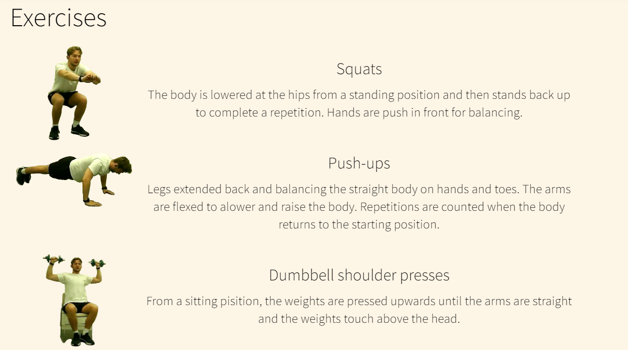
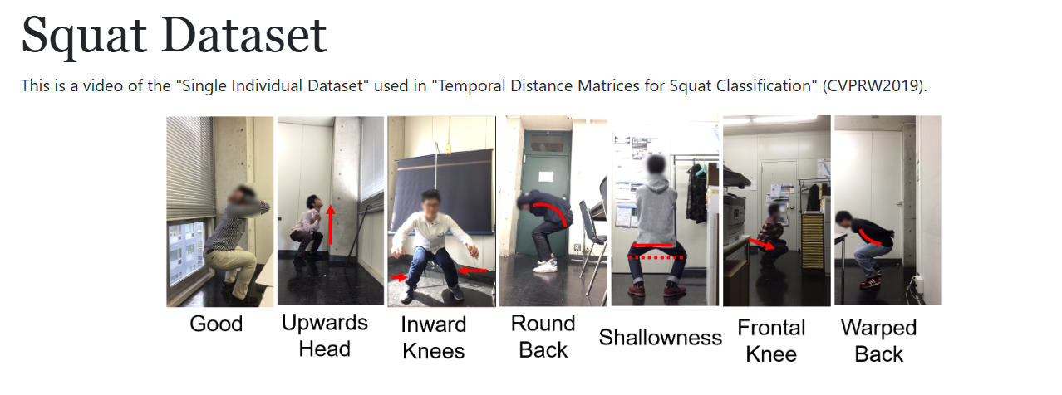
Data Access Challenges
1- Data Links Provided by Doctor:
MMFIT: Link
Squat Dataset: Link
2- Access Attempts and Challenges:
Week 1: Attempted to access provided datasets, but access was denied.
Week 2: Reported access issue to TA; problem remained unsolved.
Week 3: Communication with Doctor: Informed doctor of access issue; advised to collect data independently.
Outcome:
Unable to access provided data, leading to a loss of approximately 3 weeks.
Decision made to proceed with independent data collection efforts.

Slide 11
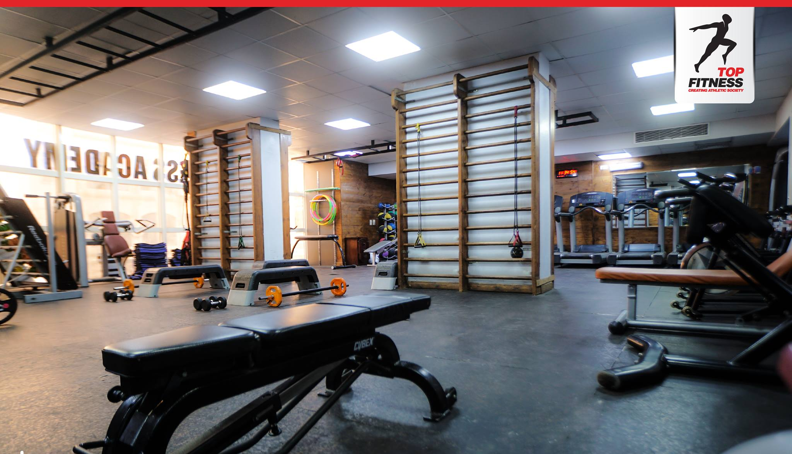

Gym Selection Process
1-Search and Negotiations:
2- Selected Gym:
Top Fitness Gym, Smouha
Conducted intensive search and negotiations with numerous gyms in Alexandria, Egypt.
Sought a gym willing to provide access without fees or formal paperwork.
We arranged to film at the Fencing Club's premises, but they later apologized due to the numerous championships being held.
Top Fitness Gym located in Alexandria, Smouha.
Chosen for its willingness to support the project without financial or administrative barriers.

Slide 12
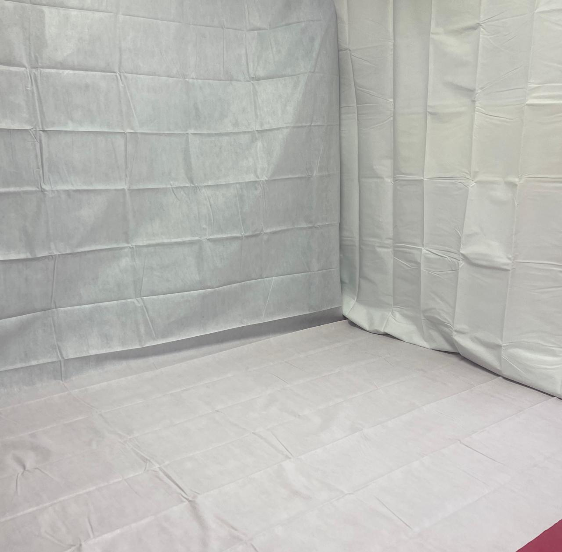
Equipment Overview
Chroma Screens
Dimensions: 3*5 meters
Purpose: Provide a consistent white background for video recordings.

Slide 13
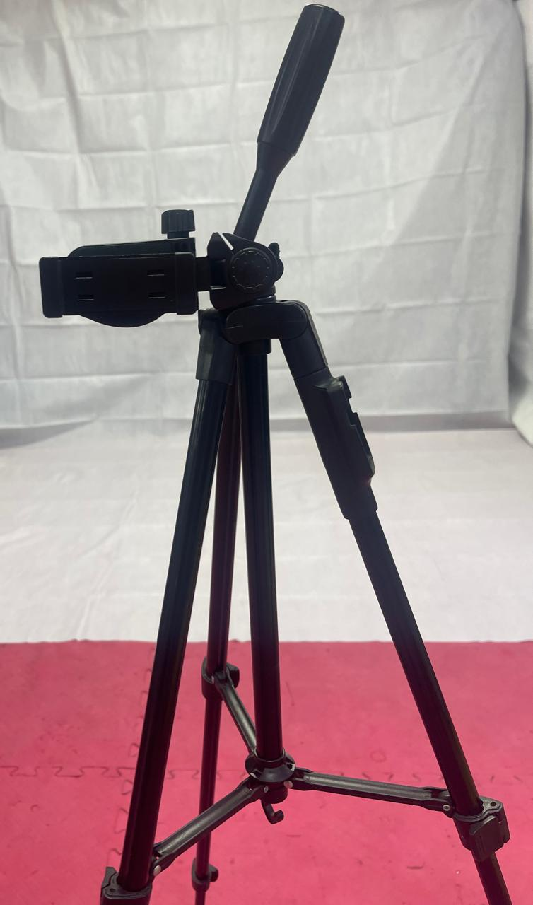
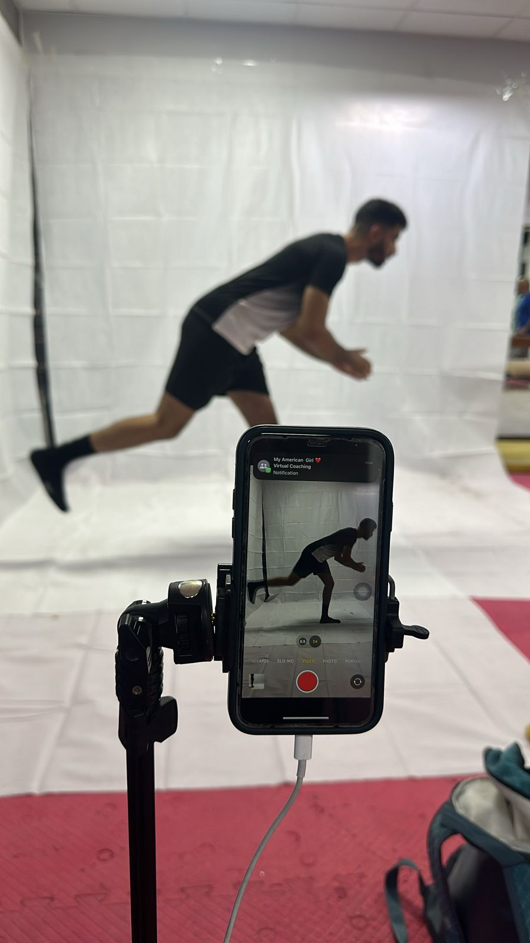
professional Tripods
Quantity: 2
Purpose: Stable support for frontal and lateral video recording.

Slide 14
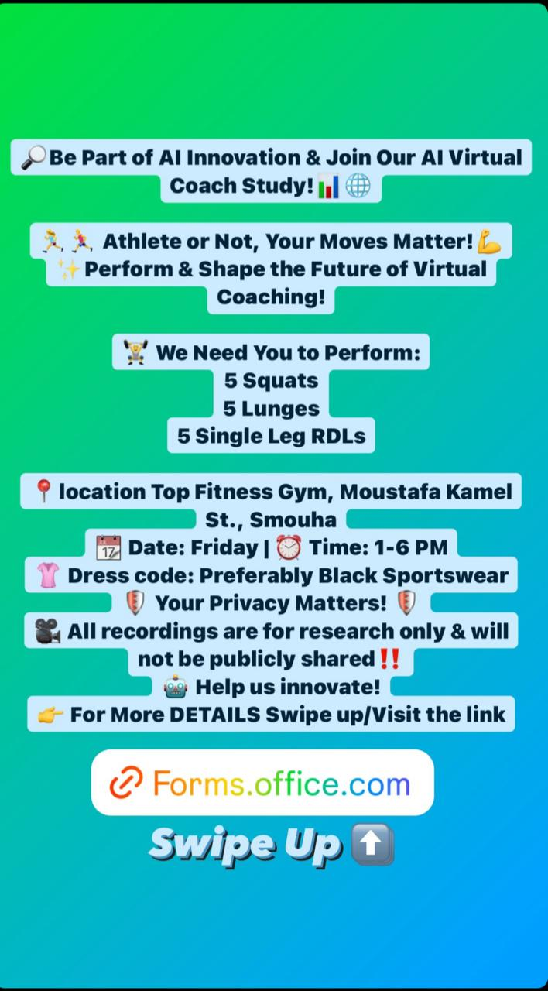
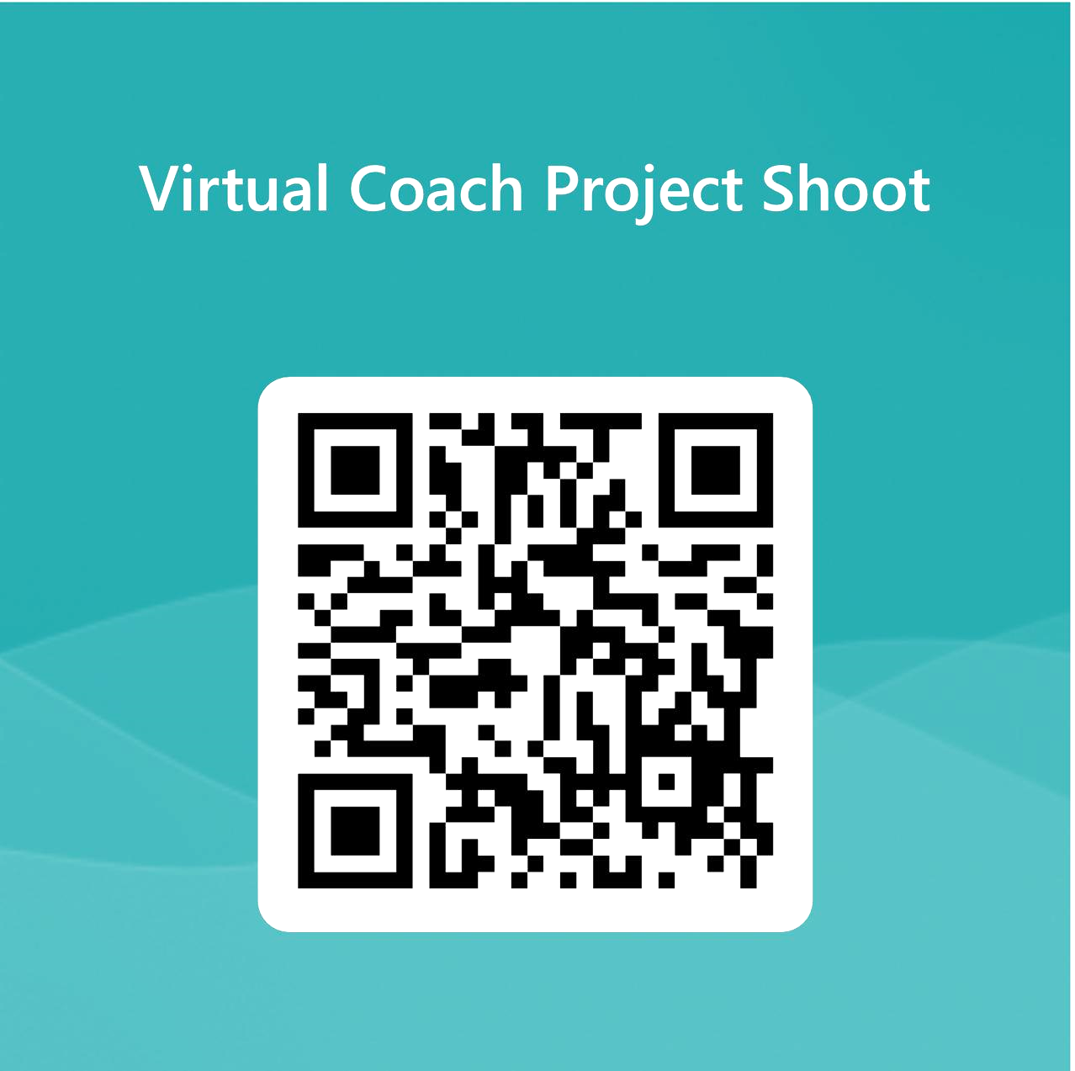
Data Collection Campaign
1- Messaging and Promotion:
Utilized Social Media posts and QR code to promote data collection campaign.
Encouraged participation from diverse groups, emphasizing the importance of every individual's contribution.
2- Participant Registration:
Created a Microsoft Form for participants to register.
Provided organized data to the gym for ease of access and cost-free entrance.

Slide 15
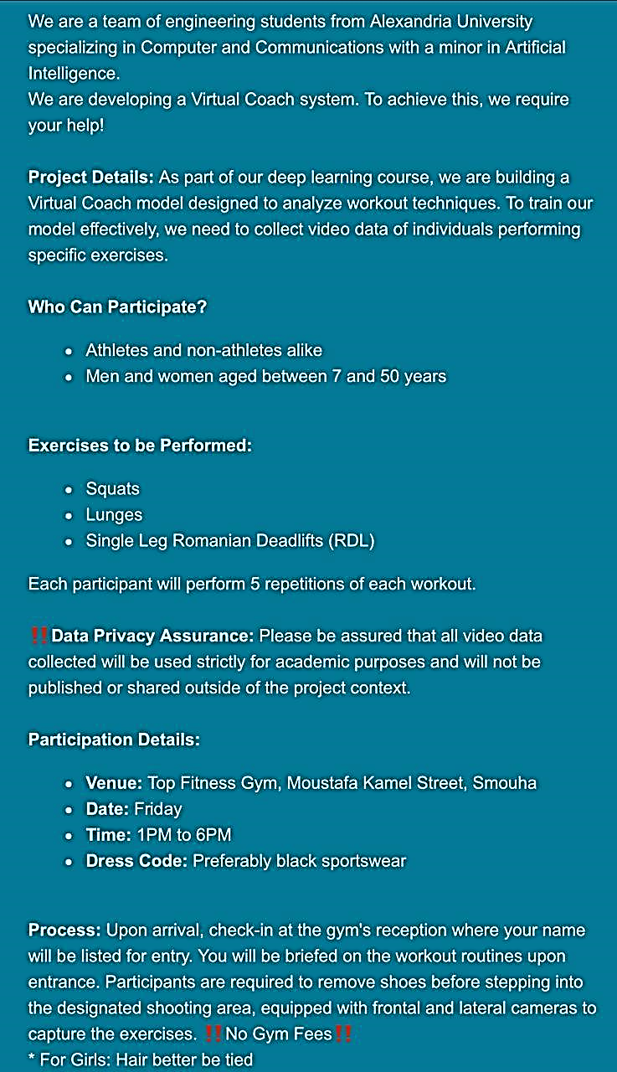
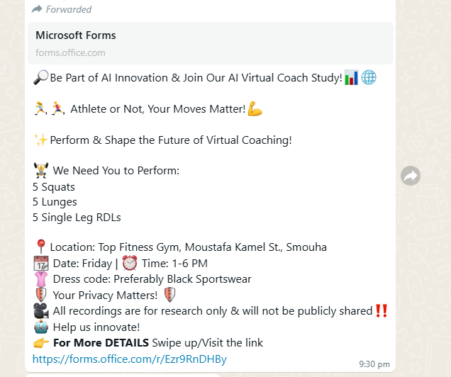
Successes and Participation
Wide Range of Participants:
Engaged professional athletes, individuals from various sports teams, and non-athletes.
Age range: 8-54 years old,
demonstrating inclusivity of the campaign.
Privacy Assurance
Conducted data collection sessions at the Gym, ensuring convenience and privacy for participants.
Emphasized privacy protection and research-only use of recordings to build trust.

Slide 16
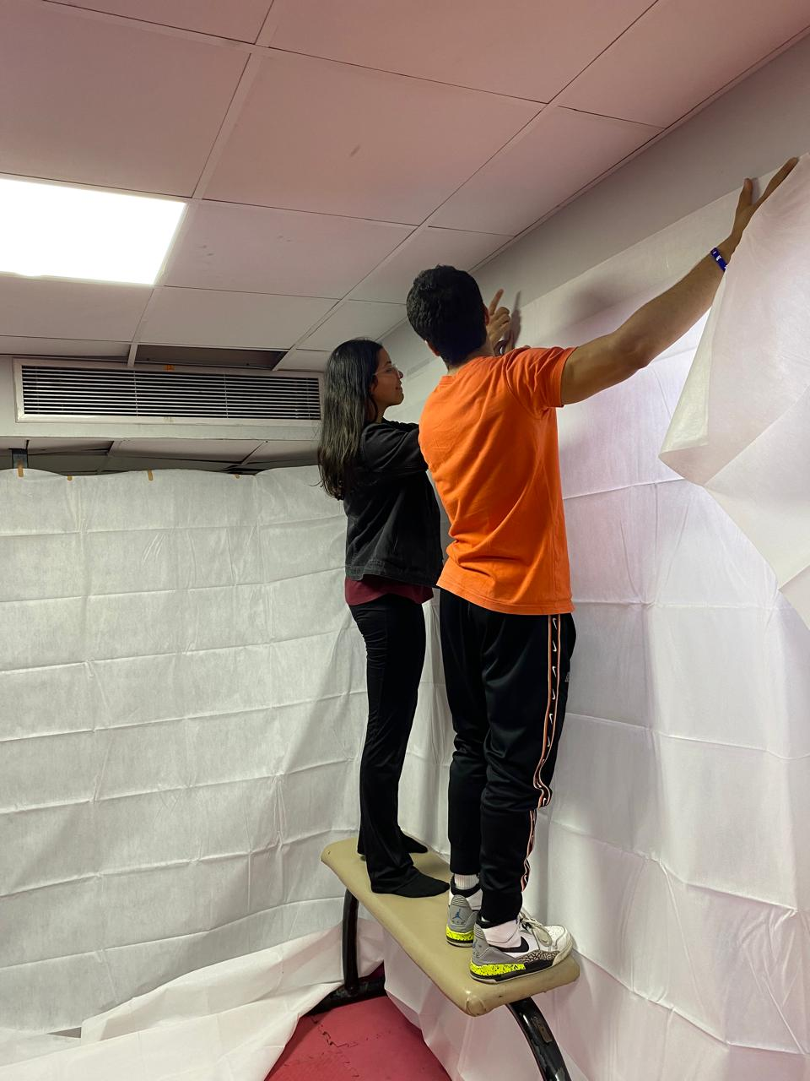
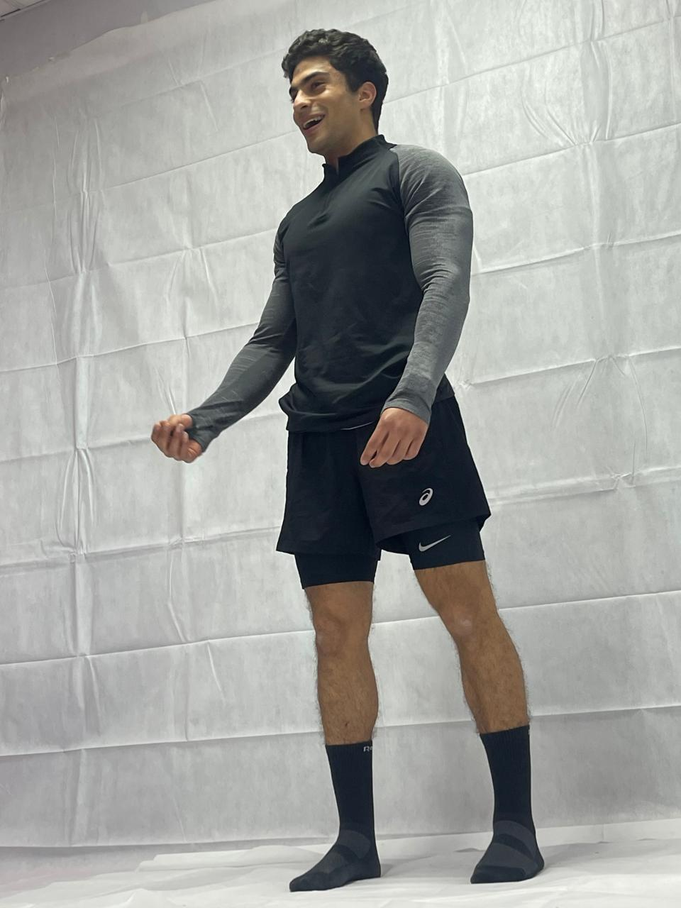
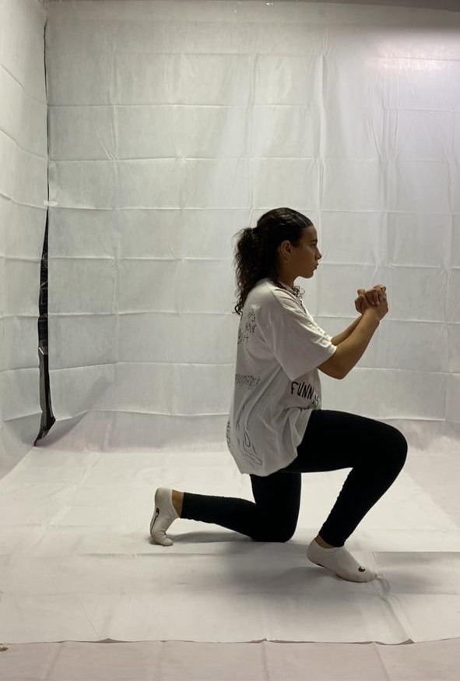

Photo showcase

Slide 17
Data Collection Progress and Collaboration
Progress Update:
Initial Agreement with Doctor:
Filming Intensity:
Utilized dedicated time efficiently to film participants performing prescribed exercises.
Ensured adherence to exercise protocols and quality of recordings.
Target: Collect data for 30 individuals.
Exercise Protocol: Each person performs 1 set of 5 repetitions for 3 exercises: Squats, 5 Lunges, and 5 Single Leg RDLs.
Participant Engagement:
Successfully engaged with a diverse range of participants, fulfilling the target set by the doctor.
Collaboration with gym staff facilitated smooth data collection operations.
Dedicated Filming Days:
Allocation: 3 full days dedicated solely to the data collection project.
Supervision: Doctor and TA attended one of the filming days, providing guidance and support.

Slide 18
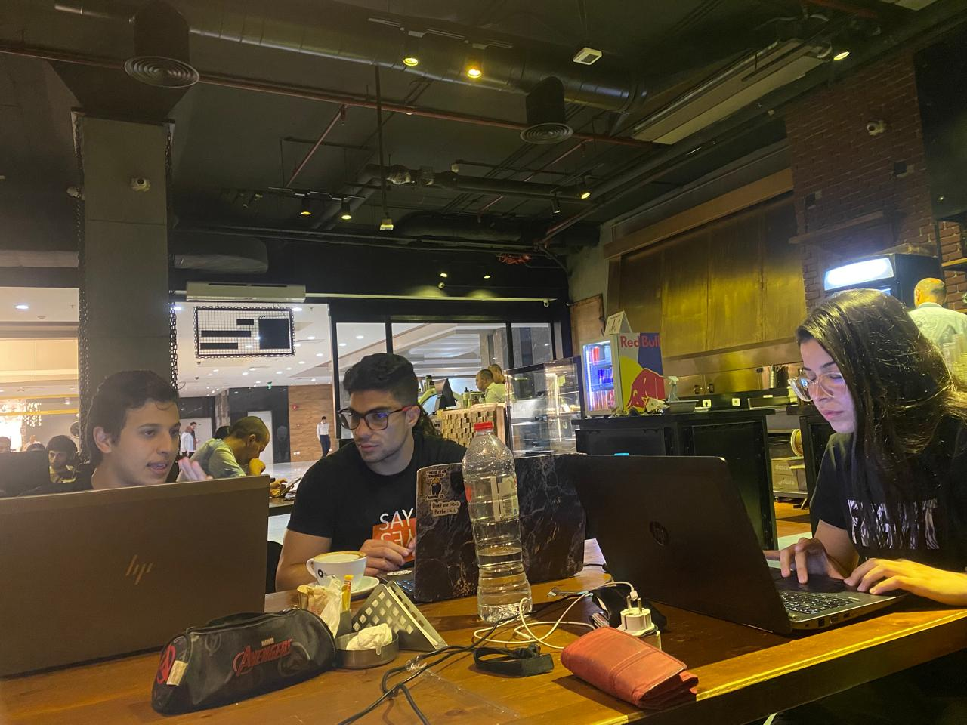
Enhanced Data Annotation and Collection
Revised Filming Protocol
Additional Annotations Required
Updated Exercise Sets:
Revised Protocol: 3 sets for each exercise, with 5 repetitions per set.
Ensured comprehensive data collection to meet updated annotation requirements.
Doctor's Update: Weight and height annotations needed for each participant.
Increased Iterations: More than five iterations per exercise set required.
Metadata Collection
Time-consuming task of gathering weight and height data for all participants.
Coordination with participants for accurate metadata retrieval.

Slide 19
🌟 50 individuals 🌟
🚺 Females: 14 🚹 Males: 36
15-45
Total Participants Filmed
Gender Distribution
Total Exercises Repitition per person

Slide 20
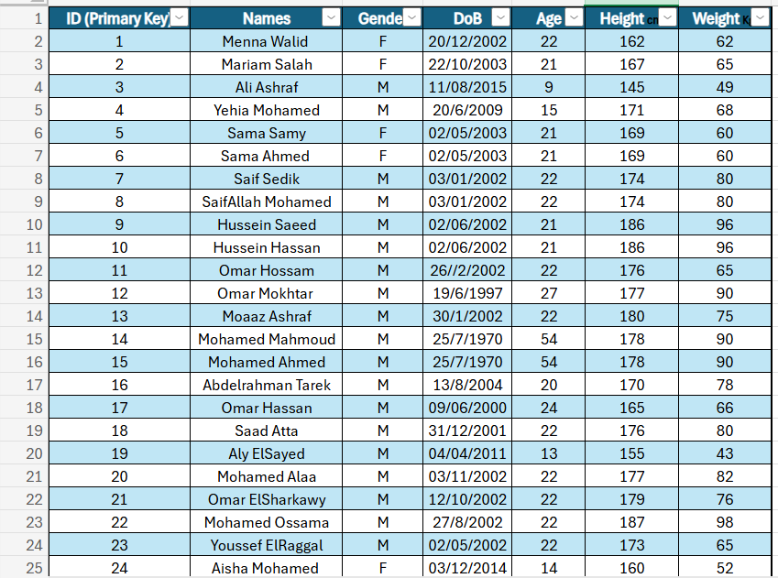
Completion of Metadata Annotations
1- Comprehensive Metadata Collection
Annotations Include: Name, Age, Weight, Height for each participant.
Ensured thorough documentation of participant characteristics.
Visual Representation
Snip from Excel Spreadsheet

Slide 21
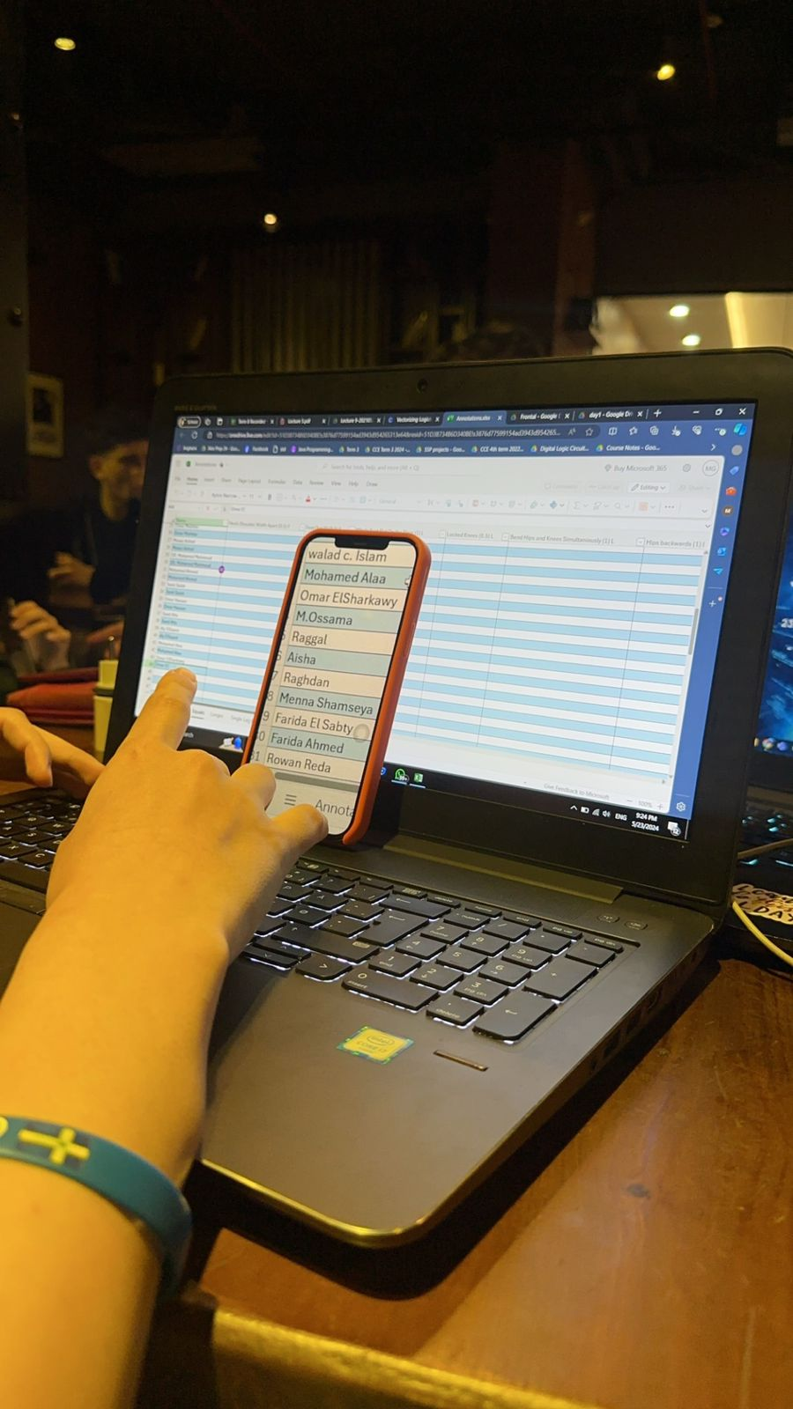
375 Videos
Data Collected

Slide 22
Data Management and Collaboration
Data Storage and Access
Unforeseen Data Loss
Google Drive Account Setup:
Established Google Drive account for centralized data storage.
Dr.Walid and TA were granted access to facilitate collaboration and data sharing.
Data Deletion Incident:
Unfortunately, videos were deleted from the drive, causing data loss and setbacks.
Incident addressed and measures taken to prevent recurrence.
Video Processing and Upload
Scoring Meeting
Videos processed, cropped, and edited for clarity and consistency.
Uploaded to Google Drive in separate files for frontal and lateral views.
Scoring Criteria Discussion:
Online meeting scheduled with doctor to
discuss required scoring criteria.
Ensured alignment and understanding of scoring standards for accurate evaluation.

Slide 23
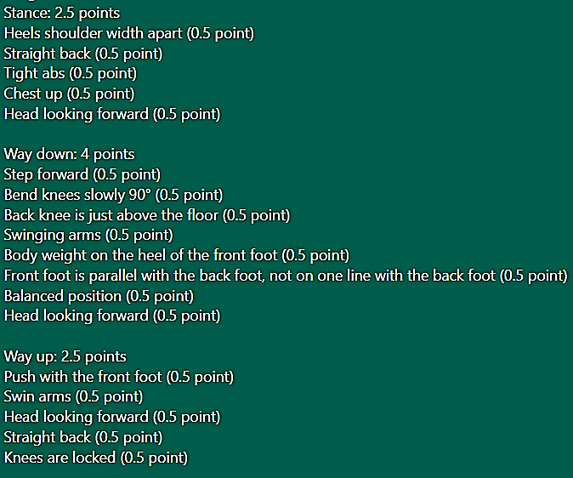
Collaboration with Expert for Scoring Criteria
Expert Collaboration for Scoring Criteria
Sample Criteria Breakdown
Example Criteria for Lunges:
Collaboration with Dr. Islam :
Dr. Islam Ezz El Din, PHD in sports biomechanics and training, joined project collaboration.
Provided expertise in exercise evaluation criteria and scoring, for an enhanced scoring process.
Professional Input for Enhanced Evaluation
Benefit of Collaboration:
Incorporating professional expertise ensures accuracy and reliability in exercise assessment.
Enhances credibility and effectiveness of virtual coaching system.

Slide 24
Refinement of Scoring Process and Completion Efforts
Annotation Protocol Update
Scoring Disagreement
Annotation Protocol Revision:
Transitioned from per-person to per-video annotation.
Streamlined annotation process for efficiency and consistency.
Updates on the sample scoring criteria was required by Dr. Walid Gomaa
Agreement reached on posting scoring criteria.
Commitment to Project Completion
Collaborative Scoring Session:
Contacted Dr. Islam for scoring all 375 videos.
Successful arrangement of meeting and completion of annotations and scoring.
Dedicated Efforts During Exams:
Invested 3 full working days during final exams for meetings and scoring sessions.
Demonstrated commitment to project success despite academic demands.
Final annotations, Meta Data and Scoring: Excel Spreadsheet

Slide 25
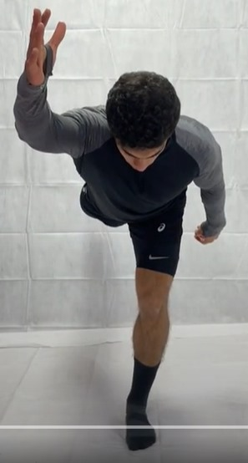
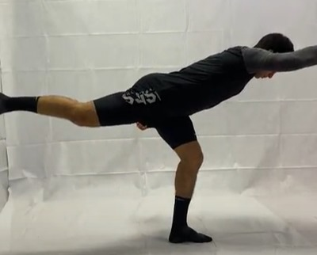
scoring criteria for a single leg Romanian Deadlift (RDL) exercise
Stance (2 points):
Feet shoulder-width apart: 0.5 points
Straight back: 0.5 points
Tight abs: 0.5 points
Neutral position: 0.5 points
Way Down (5 points):
Step forward: 0.5 points
Weight on the heel of the front foot: 0.5 points
Move torso down: 0.5 points
Push hips backwards: 0.5 points
Full back leg extended straight: 0.5 points
Cross arms and legs movement: 0.5 points
Supported arm to the side: 0.5 points
Balance: 0.5 points
Neutral neck position: 0.5 points
Support knee bent 15-20°: 0.5 points
Way Up (2 points):
Neutral neck position: 0.5 points
Tight abs: 0.5 points
Slow reverse movement: 0.5 points
Balance straight back leg: 0.5 points
Breathing (0.5 points):
Breathing at the stance: 0.5 points
Smooth and Steady Rhythm (0.5 points)
Smooth and steady rhythm: 0.5 points

Slide 26
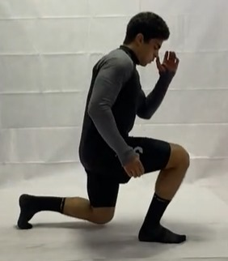
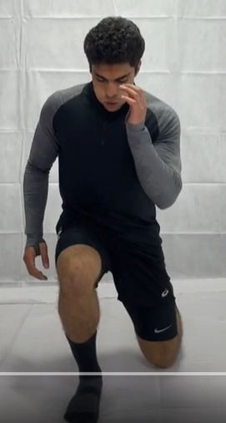
scoring criteria for the lunges exercise:
Stance (2.5 points):
Heels shoulder-width apart: 0.5 points (F)
Straight back: 0.5 points (L)
Tight abs: 0.5 points (L)
Chest up: 0.5 points (L)
Head looking forward: 0.5 points (F)
Way Down (4 points):
Step forward: 0.5 points (L)
Bend knees slowly 90°: 0.5 points (L)
Back knee is just above the floor: 0.5 points (L)
Swinging arms: 0.5 points (F)
Body weight on the heel of the front foot: 0.5 points (L)
Front foot is parallel with the back foot, not on one line with the back foot: 0.5 points (F)
Balanced position: 0.5 points (F)
Head looking forward: 0.5 points (F)
Way Up (2.5 points):
Push with the front foot: 0.5 points (L)
Swing arms: 0.5 points (F)
Head looking forward: 0.5 points (L)
Straight back: 0.5 points (L)
Knees are locked: 0.5 points (L)
Breathing (0.5 points): Breath in when lunging: 0.5 points (F)
Rhythm (0.5 points): Smooth and steady rhythm: 0.5 points (L)

Slide 27
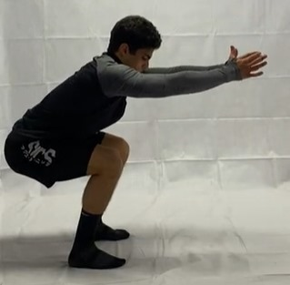
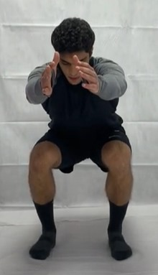
scoring criteria for the SQUAT exercise:
Stance (2.5 points):
Heels shoulder-width apart: 0.5 points (F)
Feet out 30°: 0.5 points (F)
Whole feet flat on the floor: 1 point (L)
Locked knees: 0.5 points (L)
Way Up (5.5 points):
Bend hips and knees simultaneously: 1 point (L)
Hips backwards: 1 point (L)
Knees out: 0.5 points (F)
Lower back neutral: 1 point (L)
Head looking forward: 0.5 points (F)
Chest up: 0.5 points (L)
Hips are lower than knee level: 1 point (L)
Breathing (1 point):
Breath at the stance: 0.5 points (F)
Hold breathing at the bottom: 0.5 points (F)
Between Reps (1 point):
Hips and knees are locked: 1 point (L)

Slide 28
Data Processing and Analysis Preparation
Once data is fully annotated and organized, processing becomes straightforward.
Prepared for streamlined data processing phase.
Data Processing Readiness
Parallel Learning and Analysis
Worked in parallel to comprehend time series analysis concepts.
Developed a simple notebook to facilitate understanding and application.
Equipped with knowledge and tools for advanced analysis techniques.
Ready to delve into in-depth data analysis for actionable insights.
Continuous learning and preparation ensure steady progress towards project objectives.
Ready to leverage acquired skills for impactful outcomes in the next project phases.
Advanced Analysis
Forward Progress
Ready to proceed to the next phase of data analysis and model development.

Slide 29
Thanks!
Do you have any questions?

